Slide 1
RESEARCH DESIGN I | INSIGHT | 28 SEPTEMBER 2026
From concept to variable: operationalization and measurement
Dr. Emerson Do Bú

Slide 2

About me
Emerson Do Bú, social psychologist
Researcher at the Instituto de Ciências Sociais, Universidade de Lisboa (ICS-ULisboa)
Postdoc at the School of Medicine, University of Virginia, with Dr. Nao Hagiwara
Faculty of the Health Psychology graduate programme at UEPB, Campina Grande, Brazil
Section Editor at SPSR, at Trends in Psychology, and at Paidéia
What I study. Doctors spend less time with Black patients, without noticing it. Scales to measure ageism, fatphobia and ableism
Born in Brazil, living in Lisbon
1

Slide 3
SHOW OF HANDS
Did you vote in the last election you were allowed to vote in?
a) Yes
b) No
c) I was not allowed to vote anywhere
2

Slide 4
SHOW OF HANDS
Did you read or watch news about politics yesterday?
a) Yes
b) No
3

Slide 5
SHOW OF HANDS
Do you consider yourself a politically interested person?
a) Yes
b) No
c) Depends on the week
4

Slide 6
Three numbers, one room
Each question is one way of seeing political interest
Which number is the real one? There is no number until a rule produces it.
Today is about building that rule on purpose
5

Slide 7
Four words for the whole class
Concept: The idea... Political interest
Indicator: Something you can observe that stands for the idea... Voted, or not.
Variable: The indicator with its values, in your data. Voted, yes or no...
Rule: How you get from what you observed to the value. That rule is the measurement...
Stevens (1946), Science, 103, 677–680.
6

Slide 8
Where measurement sits
THEORY
concepts
induction
deduction
DATA
the record
HYPOTHESES
predictions
measurement
verification
OBSERVATION
what happens
Measurement is the arrow from what happens to your data. This class is about that one arrow.
Adapted from Pereira, Sindic and Camino (2013), Figure 2.
7

Slide 9
01
From the concept to the variable

Slide 10
The ladder, with political interest
Step | Political interest
Concept | Political interest
Definition | How much a person pays attention to public affairs and takes part in them
Dimensions | Attention. Participation
Indicators | Read news about politics yesterday. Voted in the last election
Variable and values | Attention, yes or no. Participation, yes or no. Or one score from 0 to 2
Unit of analysis | The person
8

Slide 11
Why dimensions matter
Religiosity has at least three dimensions. Believing, practising, belonging
In Britain many people believe without belonging (Davie, 1994)
Measure religiosity as church attendance and you call them non-religious
One indicator picks one dimension, silently. Name the dimensions first
Davie, G. (1994). Religion in Britain since 1945. Believing without Belonging.
9

Slide 12
Same concept, different rules
Poverty, absolute. Income below a fixed amount per day. Counts almost nobody in Portugal
Poverty, relative. Income below 60% of the national median. The Eurostat rule. Counts many more
Poverty as deprivation. Cannot afford items on a list of essentials. Counts different people again
The rule decides who is poor. Choose it for a reason, and write the reason down
Eurostat, at-risk-of-poverty rate, 60% of the national median equivalised income.
10

Slide 13
EXERCISE
Your concept, the first three steps
Write your concept in one word
Define it in one sentence
Name two dimensions, and one observable indicator for each
11

Slide 14
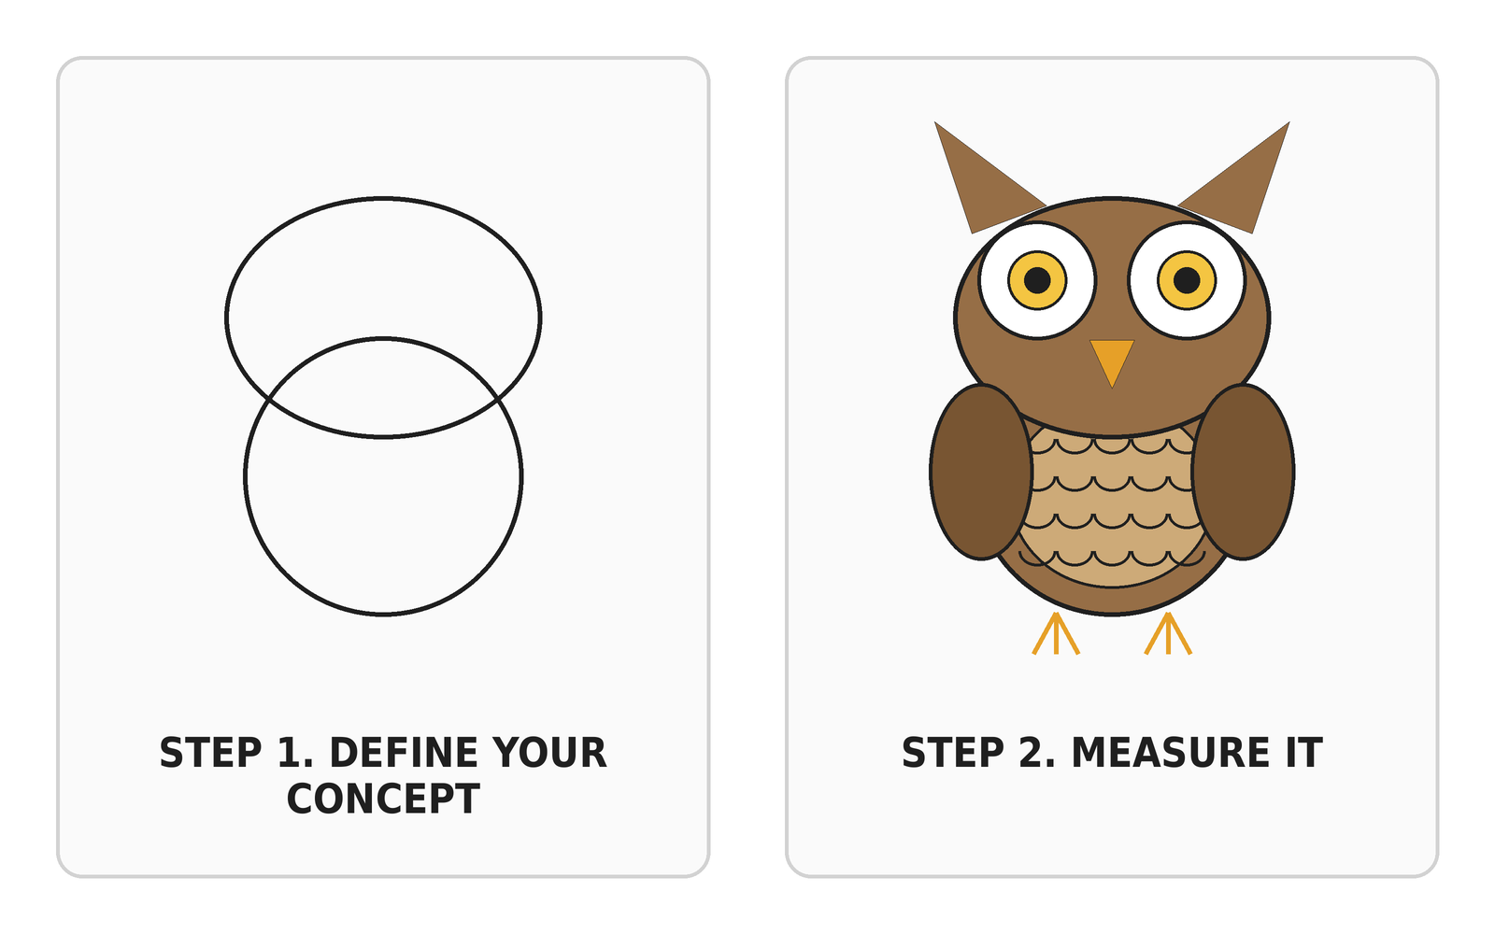
Most methods sections
12

Slide 15
02
Variables, units, levels

Slide 16
Variable, constant, unit of analysis
Participant | 1 | 2 | 3 | 4 | 5 | 6 | 7 | 8 | 9 | 10
Age, a variable | 18 | 30 | 22 | 44 | 33 | 21 | 18 | 20 | 25 | 10
Sex, a constant here | F | F | F | F | F | F | F | F | F | F
A variable takes different values across the units. A constant does not
A constant explains nothing inside your study. If everyone is a nurse, being a nurse explains no difference between them
The unit of analysis is what carries the values. Persons, households, countries, speeches
13

Slide 17
Countries are not people
Across the states of the United States in 1930, more foreign-born residents went with higher literacy (Robinson, 1950)
Across persons, the foreign-born were less literate. Immigrants had settled where the schools were good
A pattern across countries says nothing about individuals. The ecological fallacy
The unit in your question must be the unit in your data
Robinson, W. S. (1950). Ecological correlations and the behavior of individuals. American Sociological Review, 15, 351–357.
14

Slide 18
Political interest at four levels of measurement
Level | Political interest as | What you can compute
Nominal | Interested, or not | Counts, proportions
Ordinal | Not at all, hardly, quite, very. The European Social Survey item | Medians. More or less than
Interval | A 0 to 10 thermometer | Means, differences
Ratio | Minutes of political news per day | Ratios. 'Twice as much'
Stevens, S. S. (1946). On the theory of scales of measurement. Science, 103, 677–680.
15

Slide 19
Two rules about levels
You can always go down later, from years to age groups. You can never go up
So collect at the highest level that is valid and feasible. Ask years, not brackets, if people will answer
Treating agreement from 1 to 5 as a number is a decision. Make it out loud, and be ready to defend it
16

Slide 20
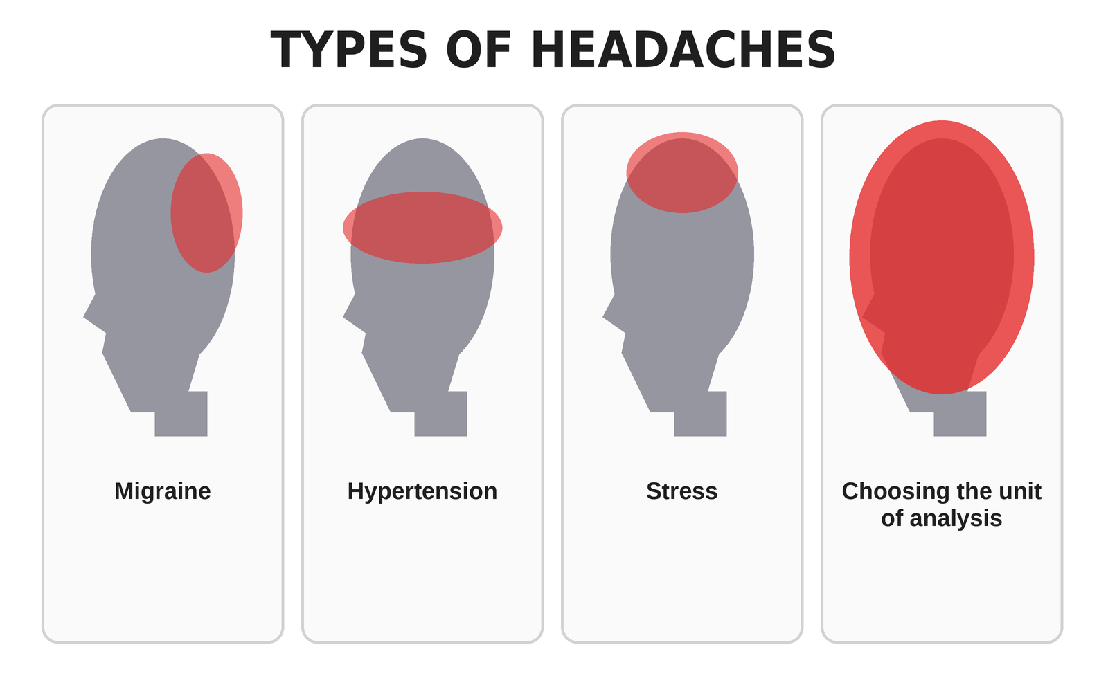
Small print on the unit of analysis
17

Slide 21
03
Good and bad measures
Notes:
16:40.

Slide 22
Reliability and validity
Reliability. The same rule gives the same result again. Precision
Validity. The rule captures the concept, and not a neighbour. Aim
Prejudice, not racism. Political interest, not knowledge of Portugal
A measure can be reliable and wrong. A bathroom scale that is always two kilos heavy
Carmines, E. G., & Zeller, R. A. (1979). Reliability and Validity Assessment. Sage.
18

Slide 23
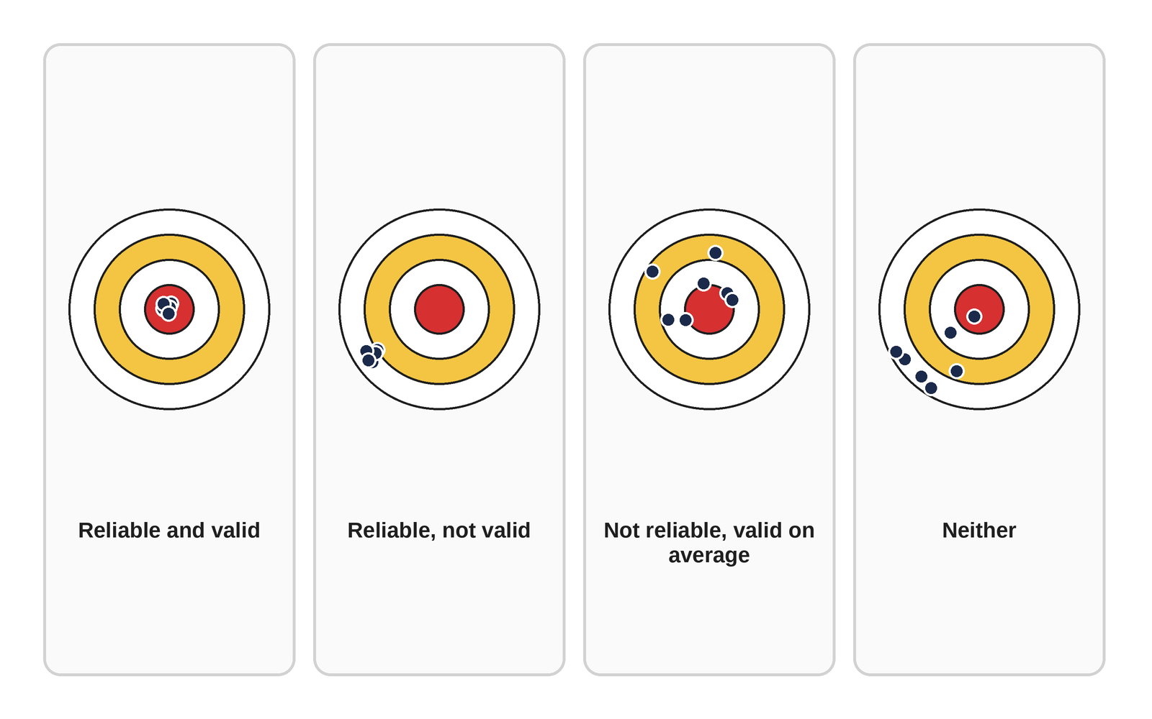
Precision and aim
19

Slide 24
Checking
Reliability. Ask the same people twice, two weeks apart. Or two coders, one codebook, count the agreements
Validity. Does the measure cover the dimensions? Does it agree with a better record? Does it behave as the theory predicts?
Across countries. Does the item mean the same thing to everyone? That question sits behind every comparison
20

Slide 25
PREDICTION, SHOW OF HANDS
1940. Half of a US sample was asked whether the country should allow public speeches against democracy. The other half, whether it should forbid them. Which wording got more support for stopping the speeches?
a) 'Not allow'
b) 'Forbid'
c) About the same
21

Slide 26
One word, sixteen points
62% would not allow the speeches. 46% would forbid them (Rugg, 1941)
Same country, same year, same speeches. One word changed the rule
The wording is part of the instrument. Pre-test it, keep it identical, report it
A translation is a wording change
Rugg, D. (1941). Experiments in wording questions. Public Opinion Quarterly, 5, 91–92.
22

Slide 27
What self-reports add
People say what sounds right.
People agree with statements whatever they say. Reverse half of your items
Cultures answer differently. Extremes in one country, the middle of the scale in another
Self-report is a fine tool with known blind spots. Know them
23

Slide 28
What people do, without being asked
The floor tiles in front of a museum's most popular exhibit wore out in weeks, elsewhere in years (Webb et al., 1966)
Reaction times reveal attitudes people do not report. The Implicit Association Test
Consultation time as a measure of bias. Doctors spend less time with Black patients and do not know it. Intergroup Time Bias, our work in Brazil, Portugal and the United States
Records kept for other reasons. Nobody performs for the researcher. Ethics first
Webb, Campbell, Schwartz & Sechrest (1966). Unobtrusive Measures. Vala, Pereira, Lima & Leyens (2012), Personality and Social Psychology Bulletin, 38, 491–504.
24

Slide 29
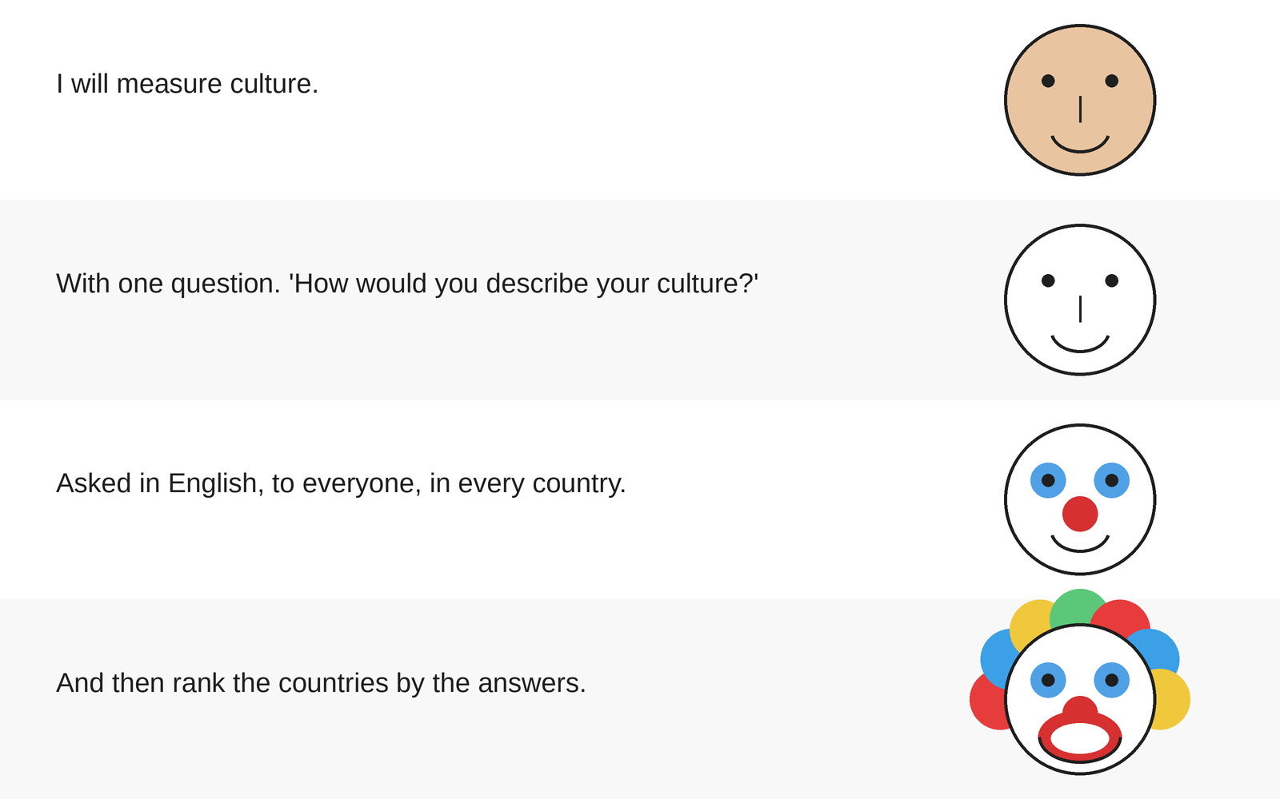
Operationalising 'culture'
25

Slide 30
04
Tools
Notes:
17:03.

Slide 31
The route and the tool
The route is how you answer the question. Watch things happen, or intervene and compare. That is 19 October
The tool records the variable. Questionnaire, interview, observation, archive, register
Any route can use any tool. Quantitative and qualitative describe the tool, not the route
26

Slide 32
Six tools
Tool | Good at | Blind spot
Questionnaires and scales | Attitudes, many people quickly | Says versus does. Wording
Interviews | Meaning, reasons, sequences | Small numbers. Memory
Observation | What people actually do | Being watched changes behaviour
Documents and archives | The past, institutions | Only what someone wrote down
Registers and digital traces | Whole populations over time | Only who is in the system
Unobtrusive measures | Behaviour nobody performs for you | Meaning must be inferred
27

Slide 33
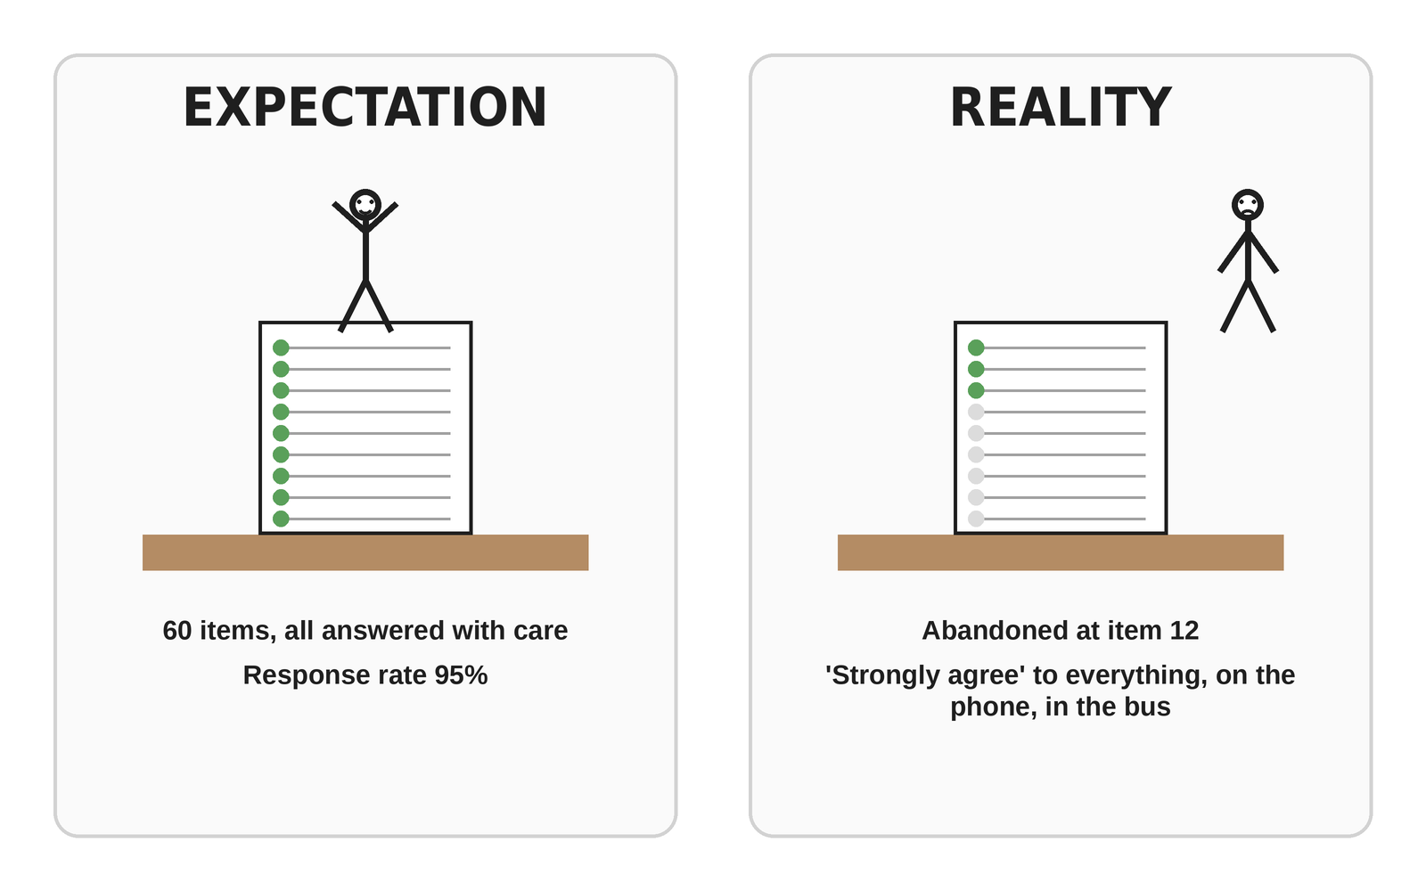
The 60-item questionnaire
28
Notes:
Thirty seconds.

Slide 34
05
Your turn
Notes:
17:12.

Slide 35
EXERCISE
Your concept, all the way down
Definition, two dimensions, one indicator each
The variable, its values, its level, and the unit of analysis
One neighbouring concept your indicator might capture instead
One way to check reliability
29
Notes:
Circulate. Second commonest failure after missing dimensions: an indicator that measures the neighbour.

Slide 36
The ladder, on one page
Line | An example, housing insecurity
Concept | Housing insecurity
Definition | The degree to which a household cannot count on keeping adequate housing over the next year
Dimensions | Affordability. Stability of tenure. Adequacy
Indicators | Rent above 40% of income. Months left on the contract. Persons per room
Variable, values, level | Three ratio variables, or one 0 to 3 count, ordinal
Unit of analysis | The household
Tool | Household survey, plus the rental contract as a document
Neighbour to keep out | Poverty. A well-off household with an ending contract is insecure without being poor
Reliability check | Ask two adults of the same household separately, compare
30

Slide 37
ONE-MINUTE PAPER
One thing clearer, one thing still confusing
One sentence each
No name needed
Leave it on the desk on your way out
32
Notes:
Read them tonight. Open 12 October with the three most common confusions.

Slide 38
See you on 12 October

